Slide 1
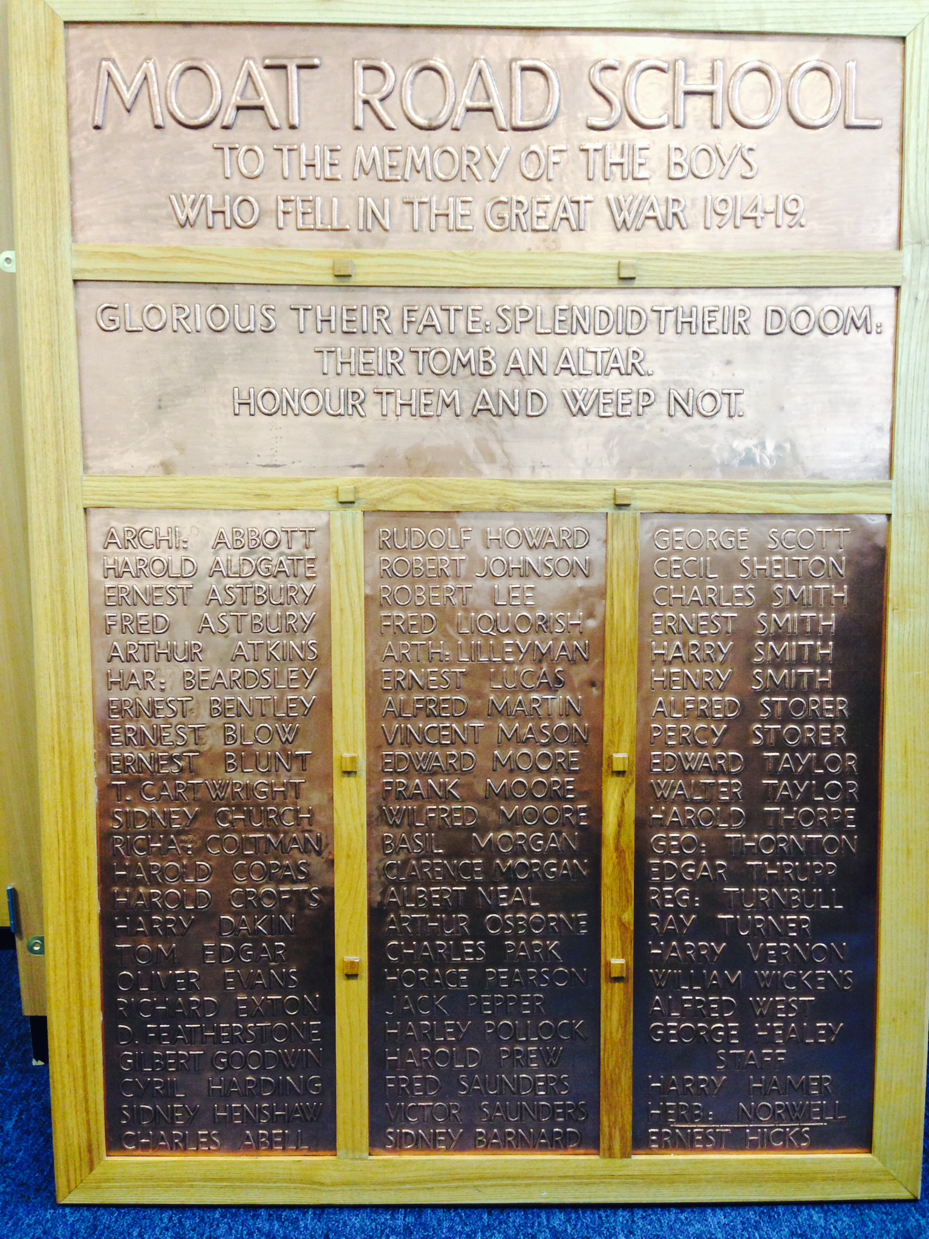
What connects us at Moat Community College with the First World War?

Slide 2
66 students and 2 teachers

Slide 3
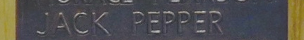
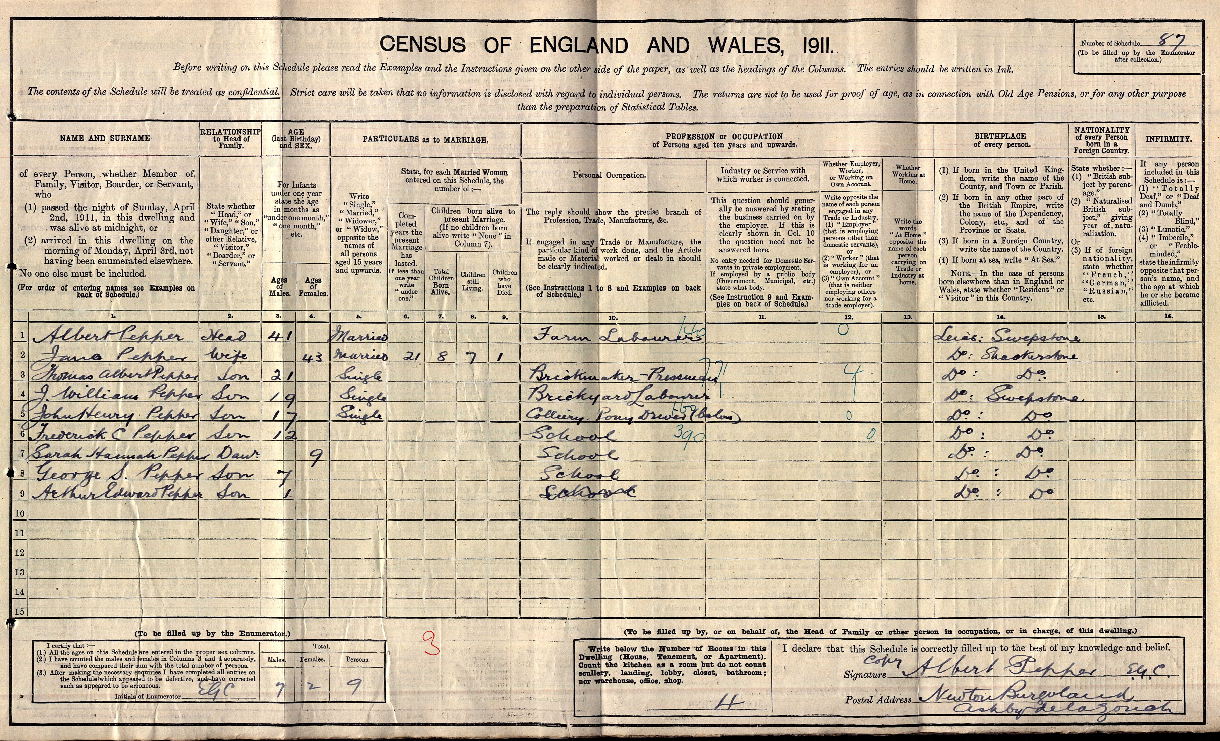

Slide 4
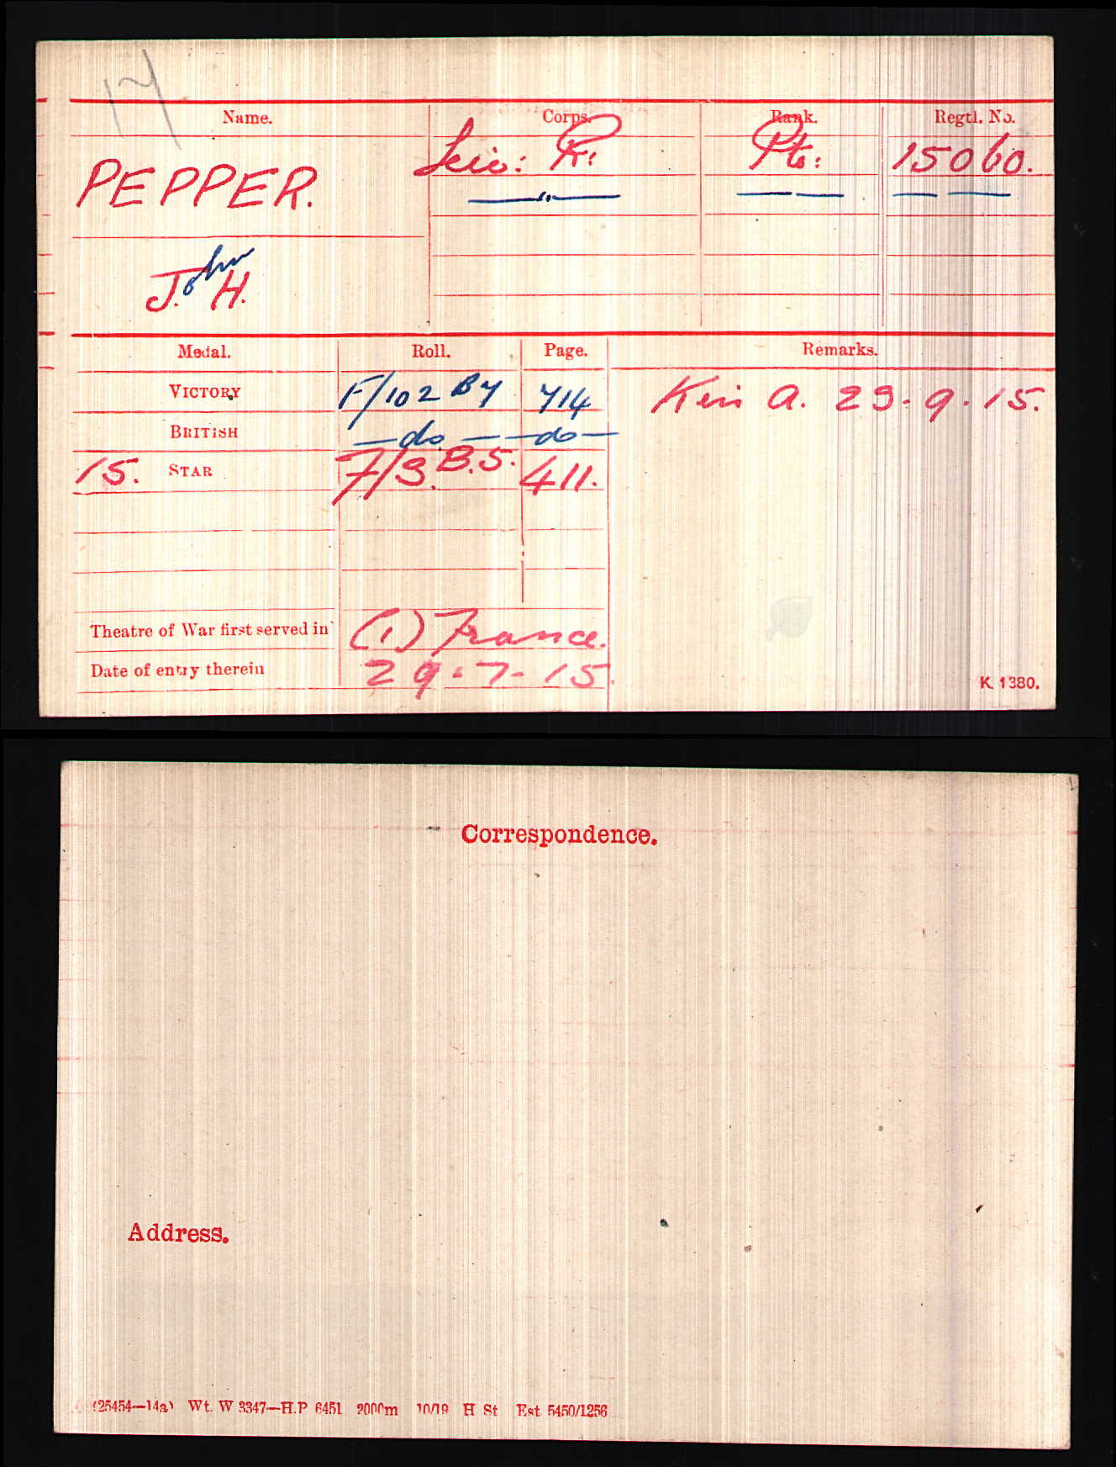

Slide 5
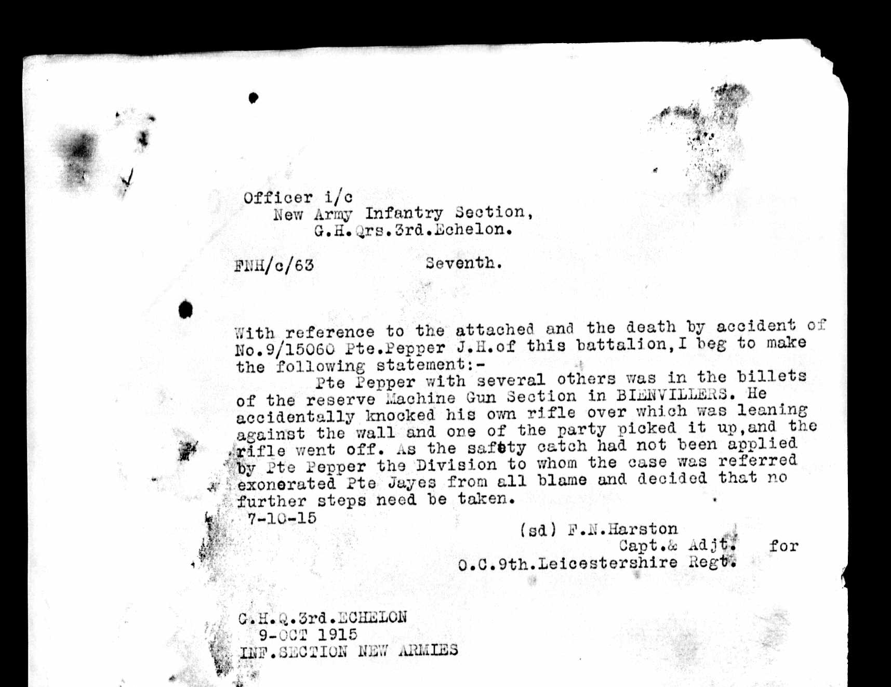

Slide 6
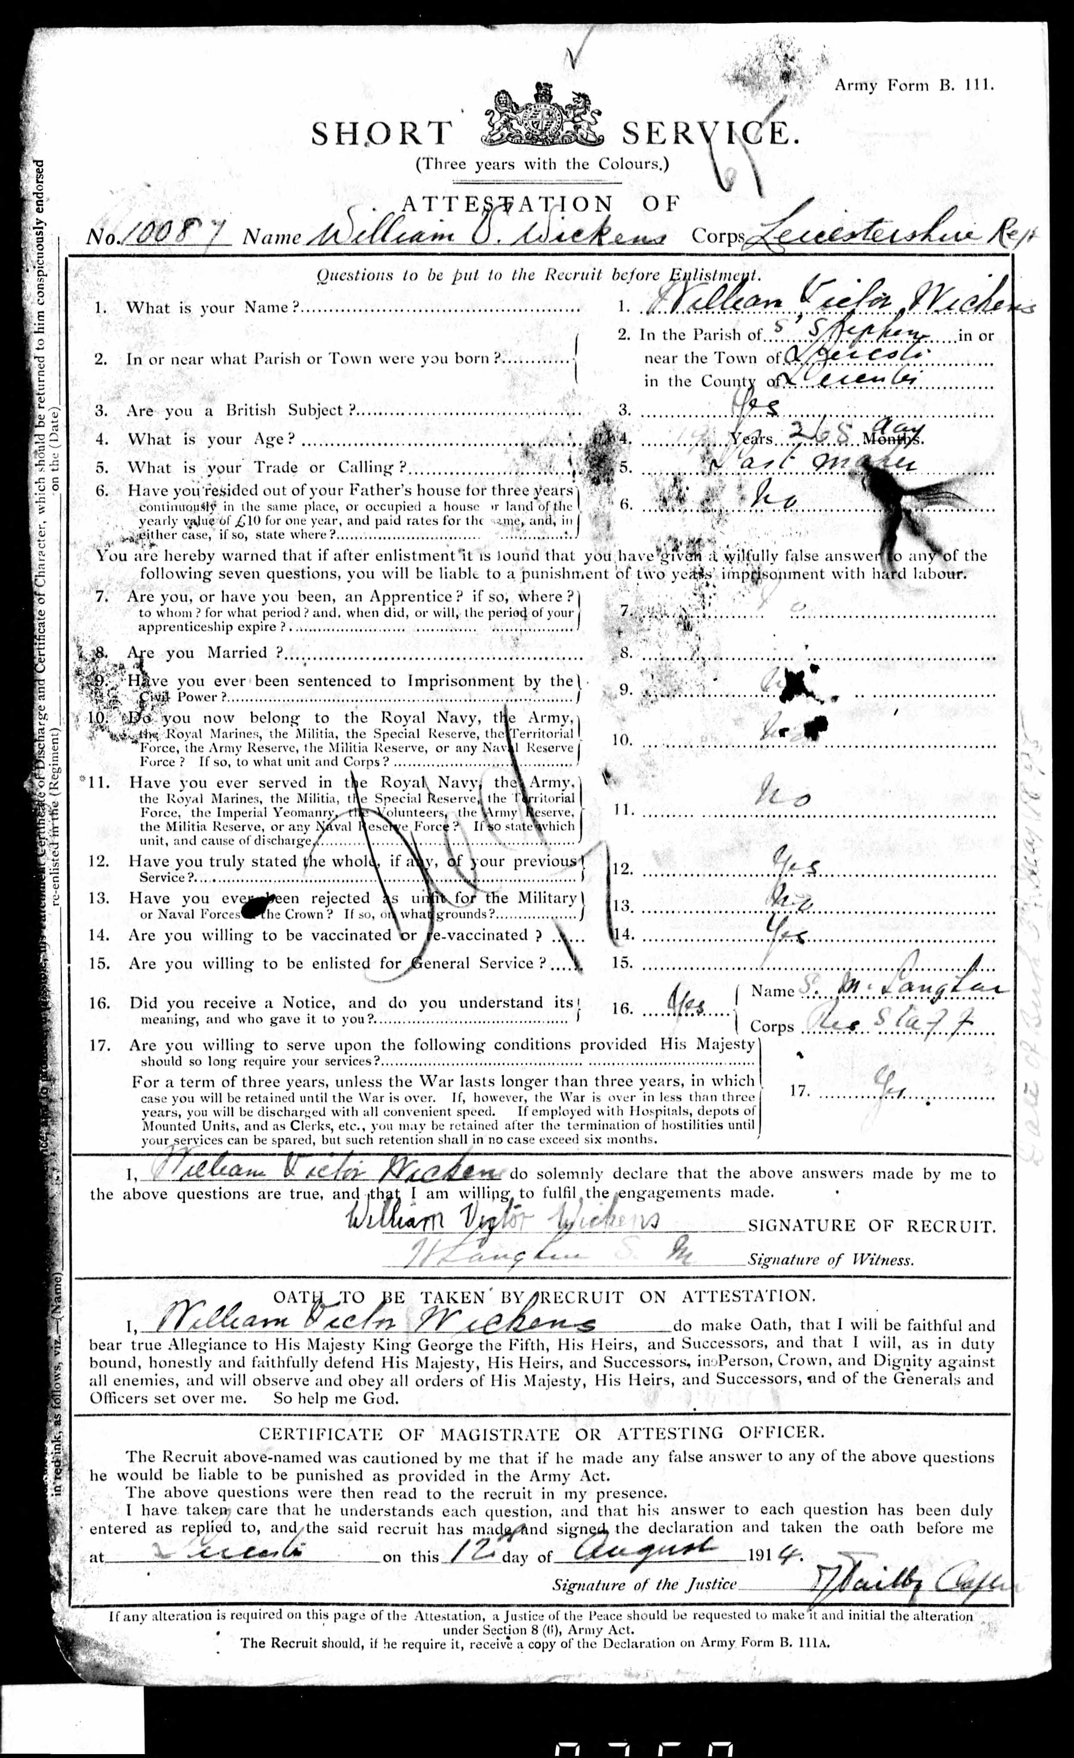

Slide 7
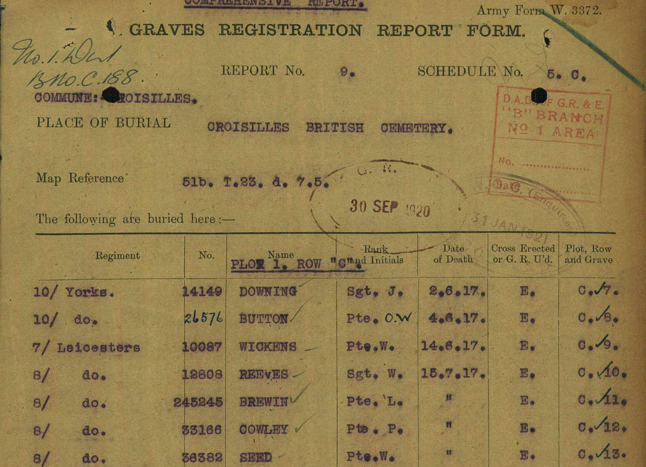
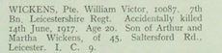

Slide 8
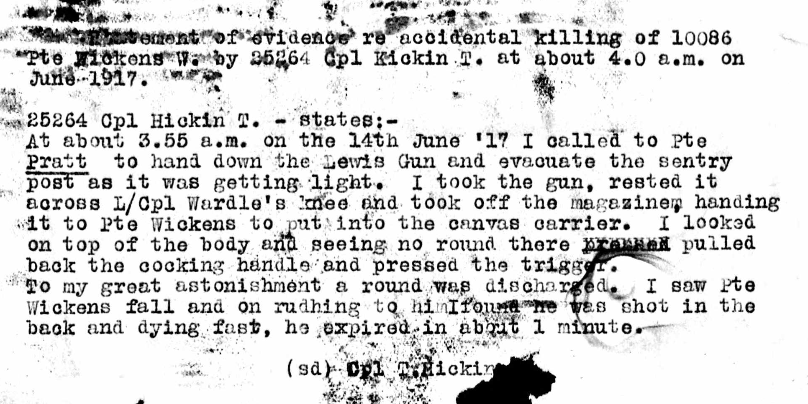

Slide 9
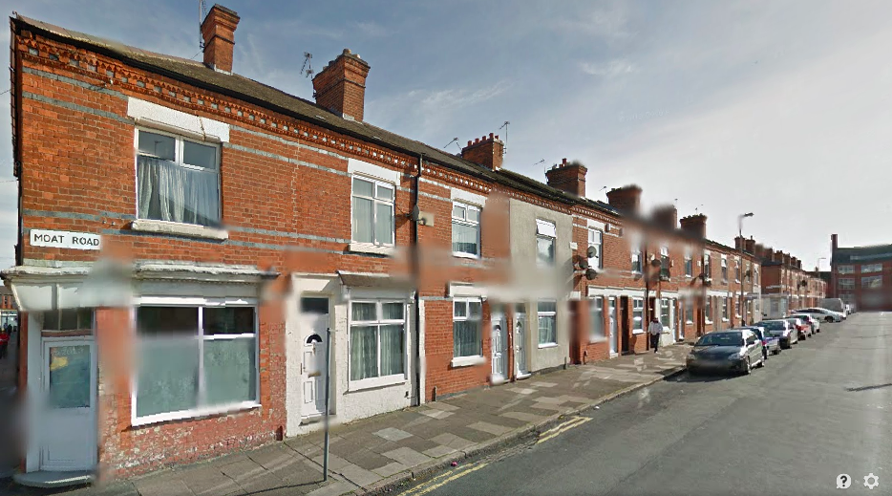

Slide 10
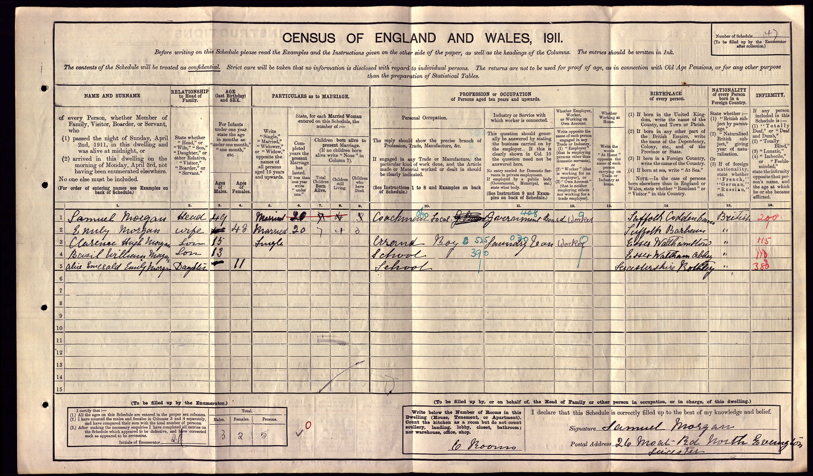

Slide 12
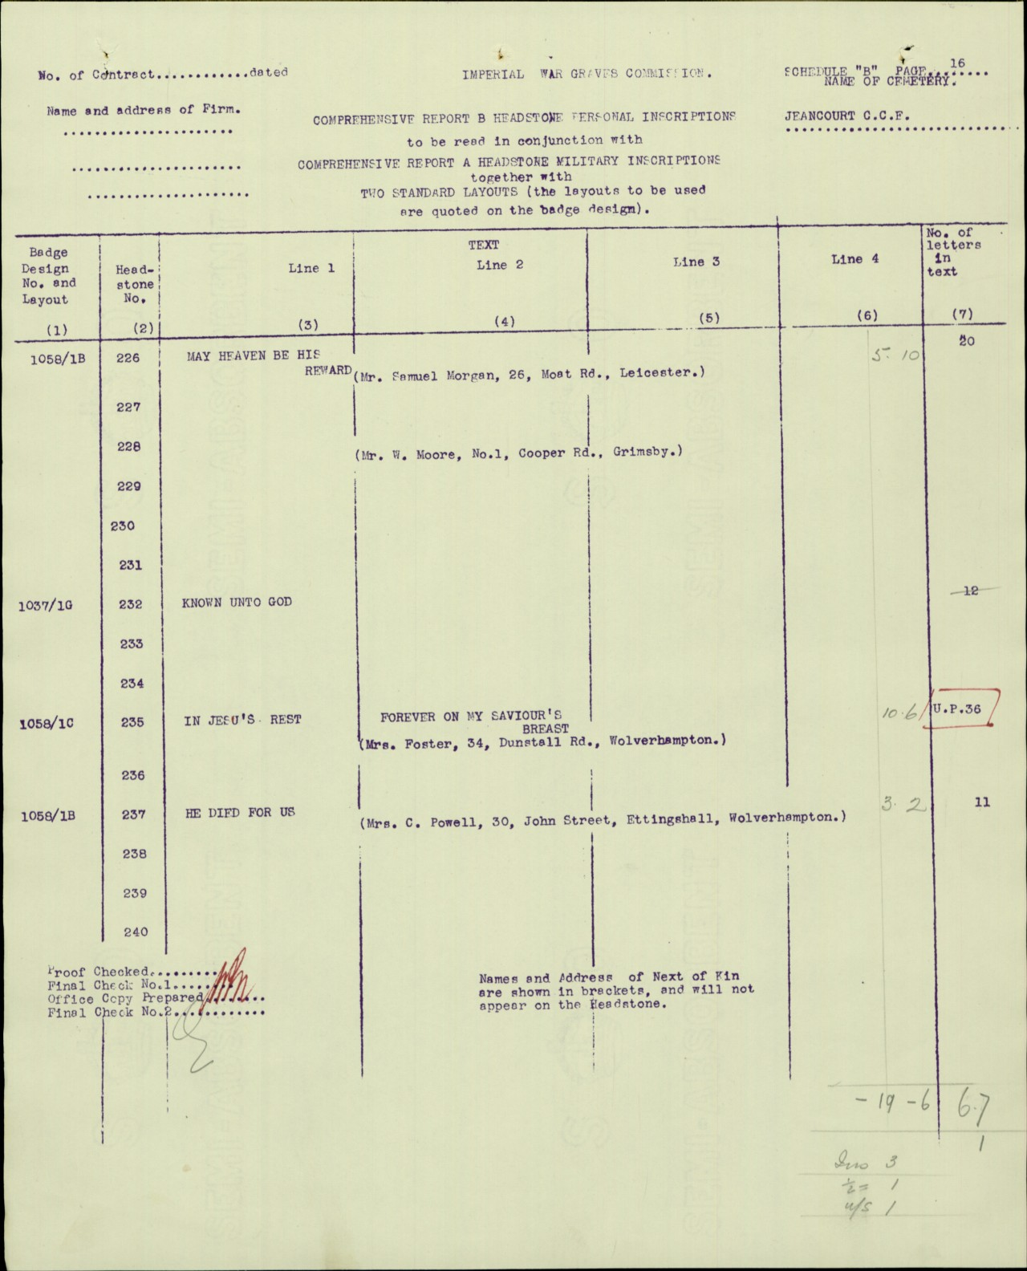

Slide 13

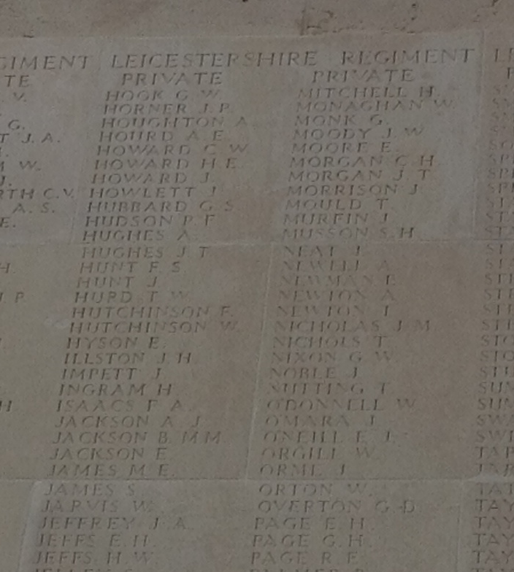

Slide 14
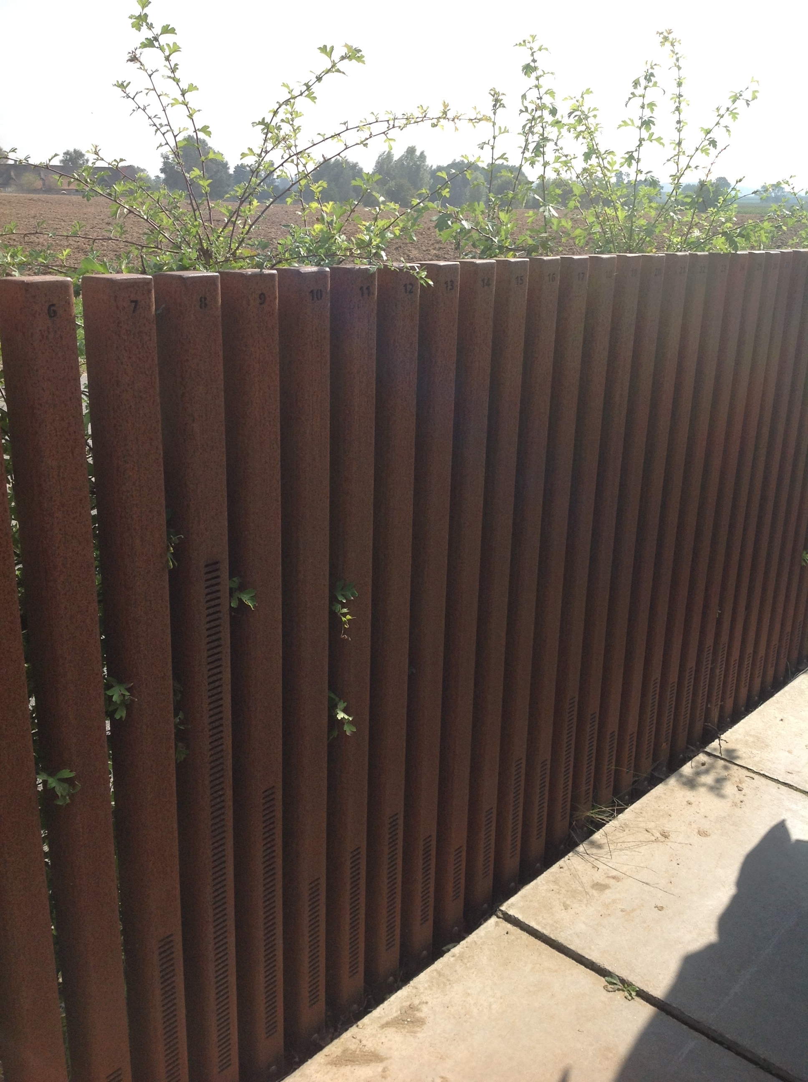
The first place we visited was Lijssenthoek Cemetery in Belgium.

Slide 15
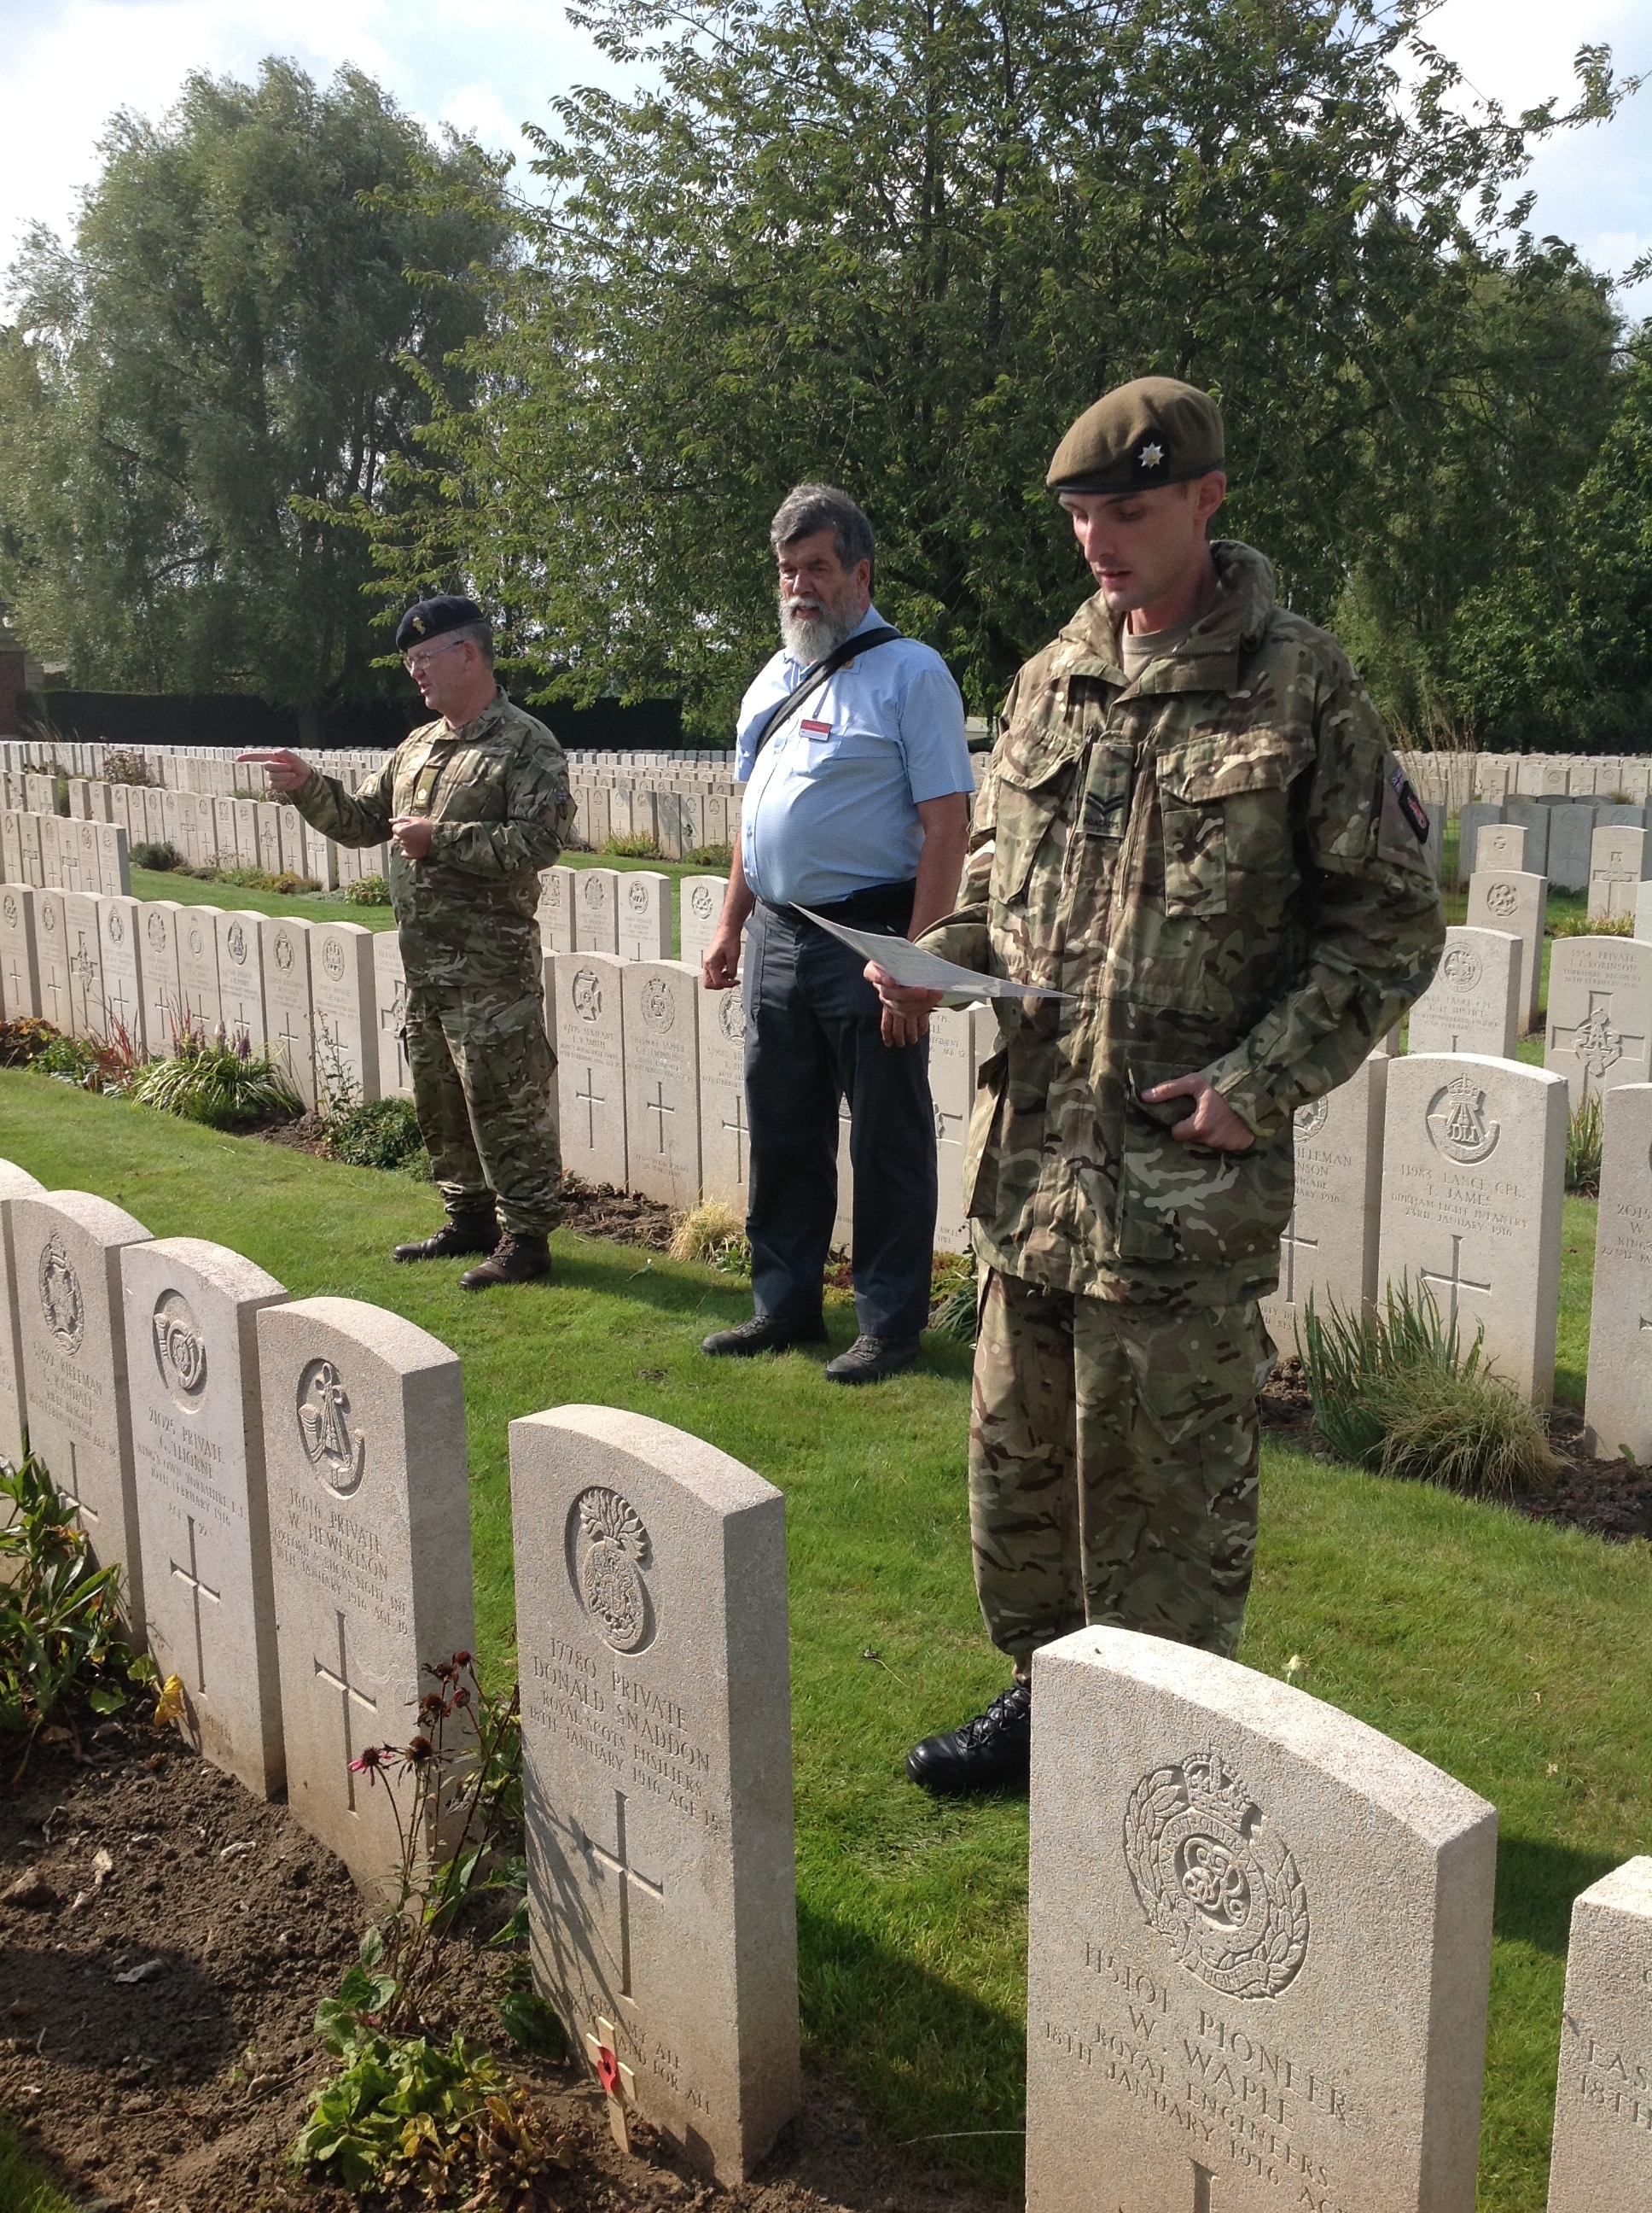
The soldier buried in this grave was only 15 years old!

Slide 16
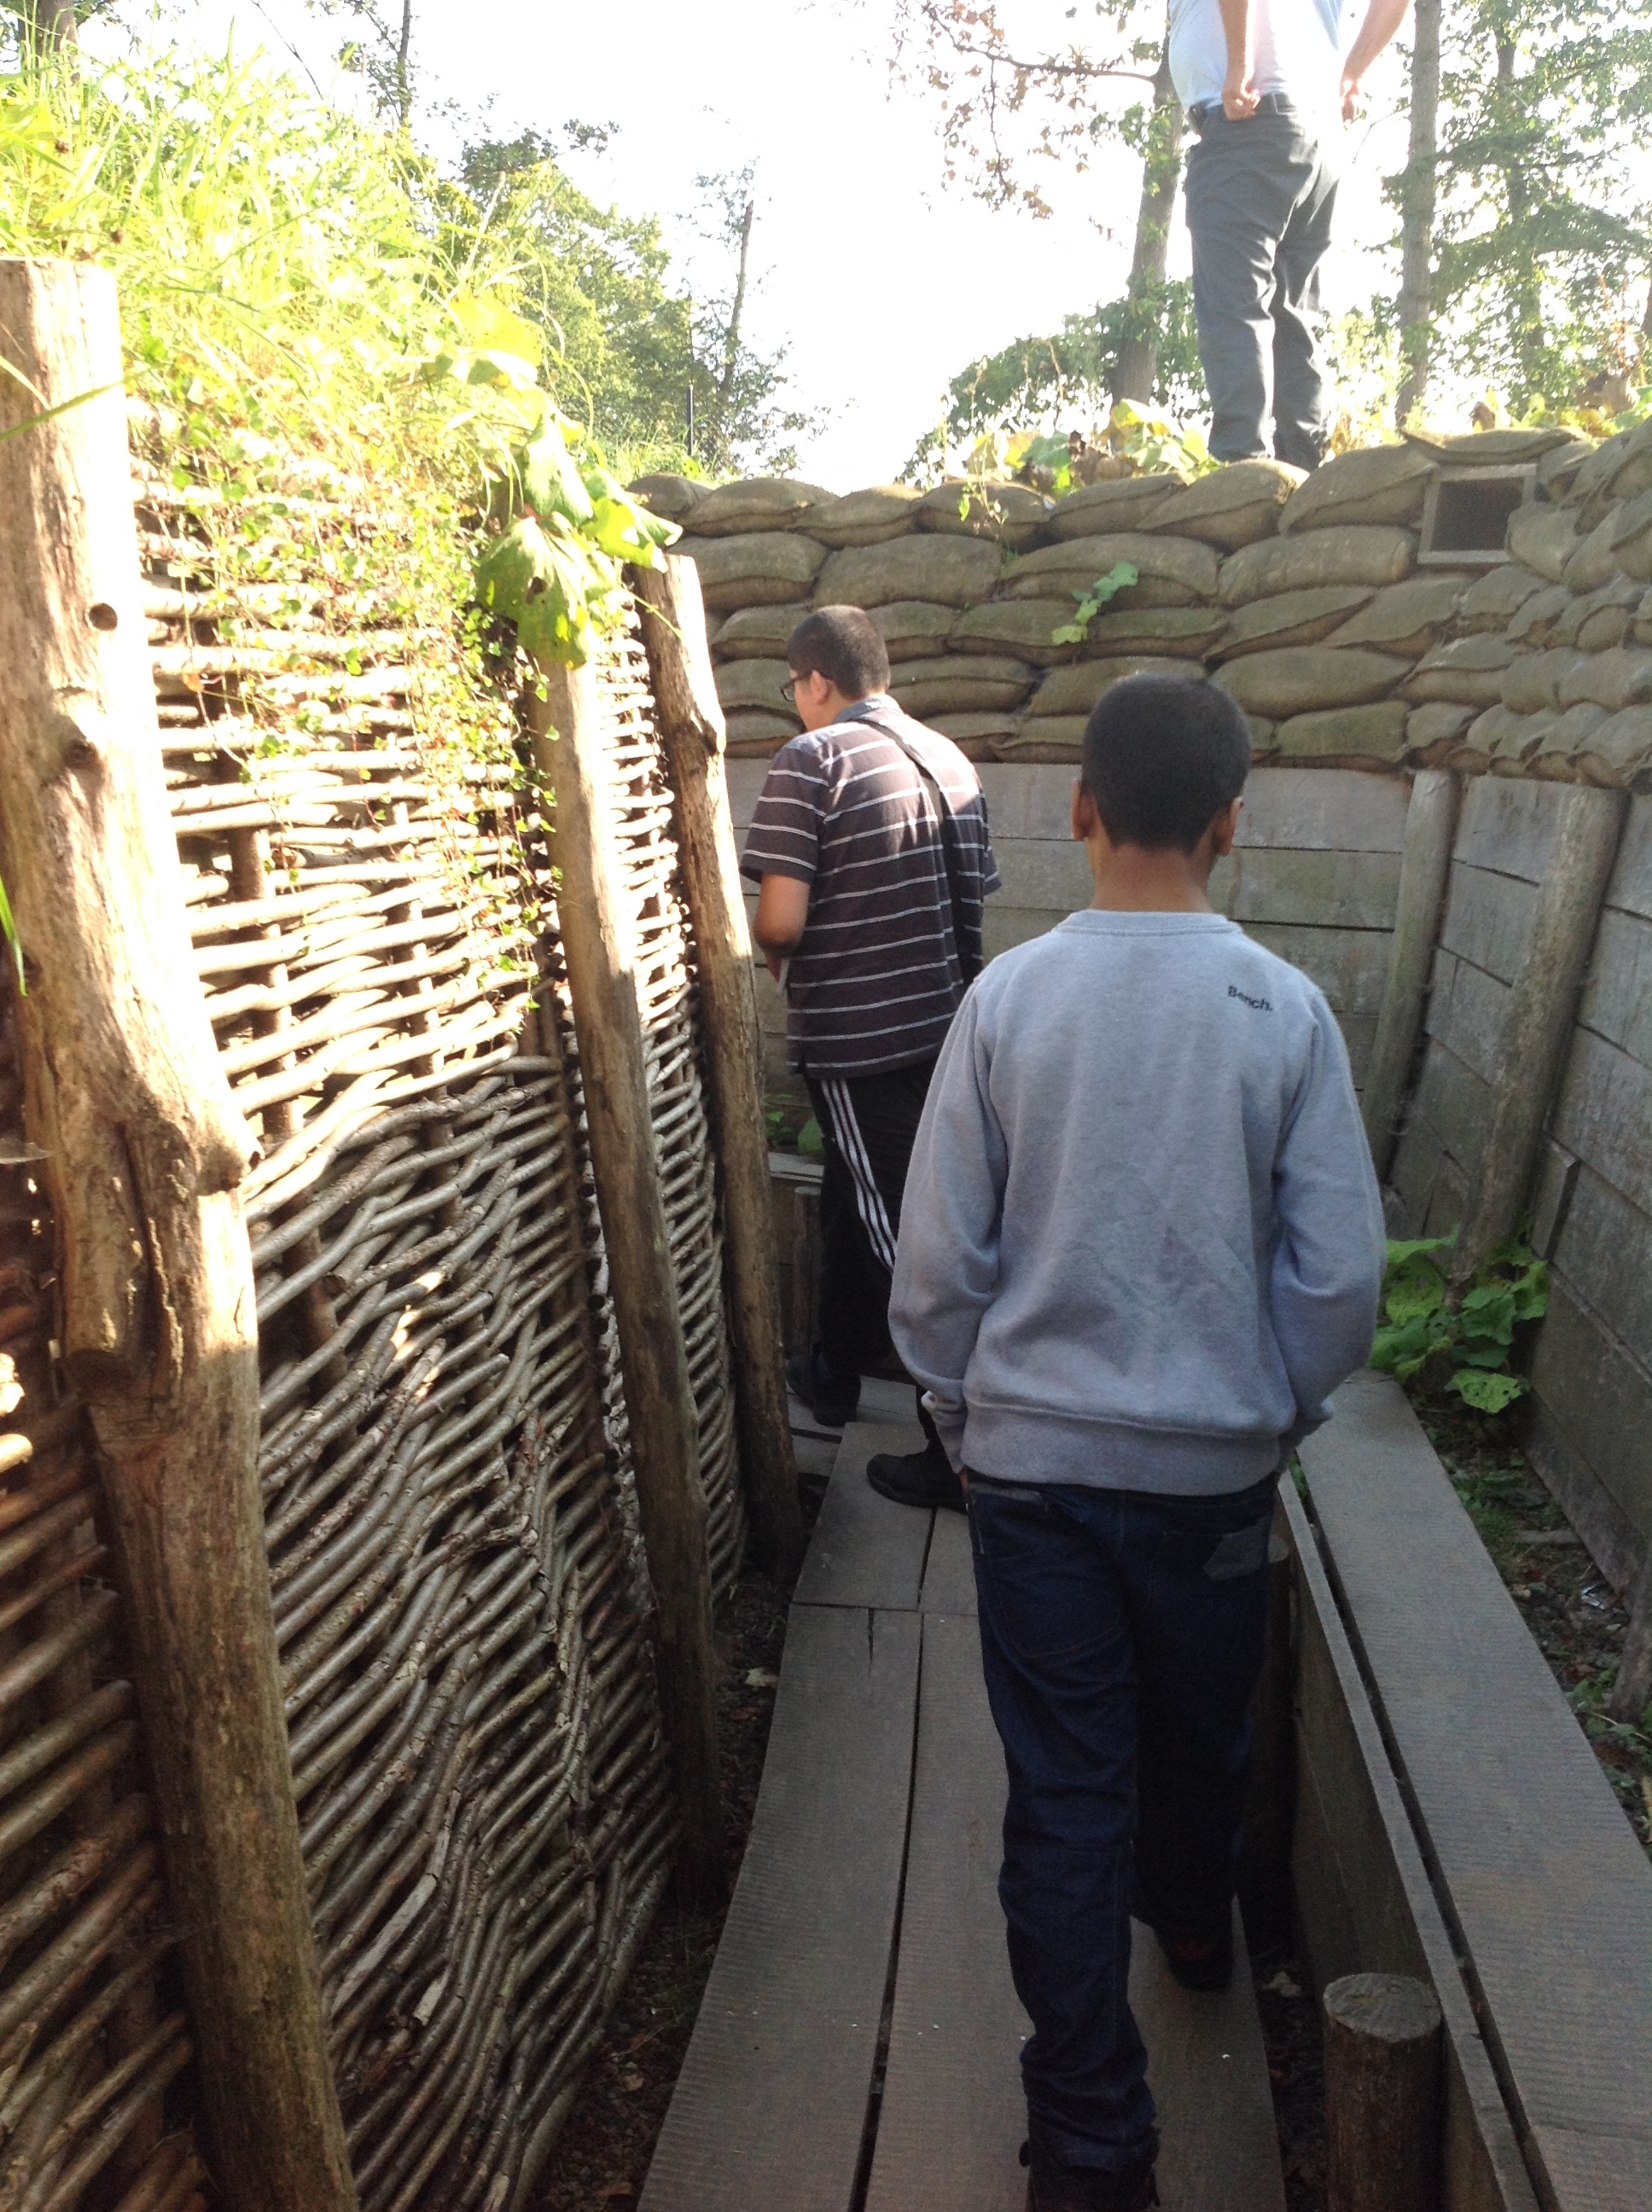
Next we visited Memorial Museum Passchendaele in Belgium.

Slide 17
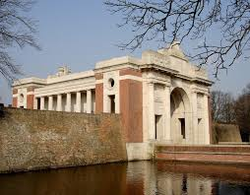
This is the Menin Gate which is in Ypres. On it are the names of 54,896 commonwealth soldiers who were killed in the area and whose bodies were never found.

Slide 18
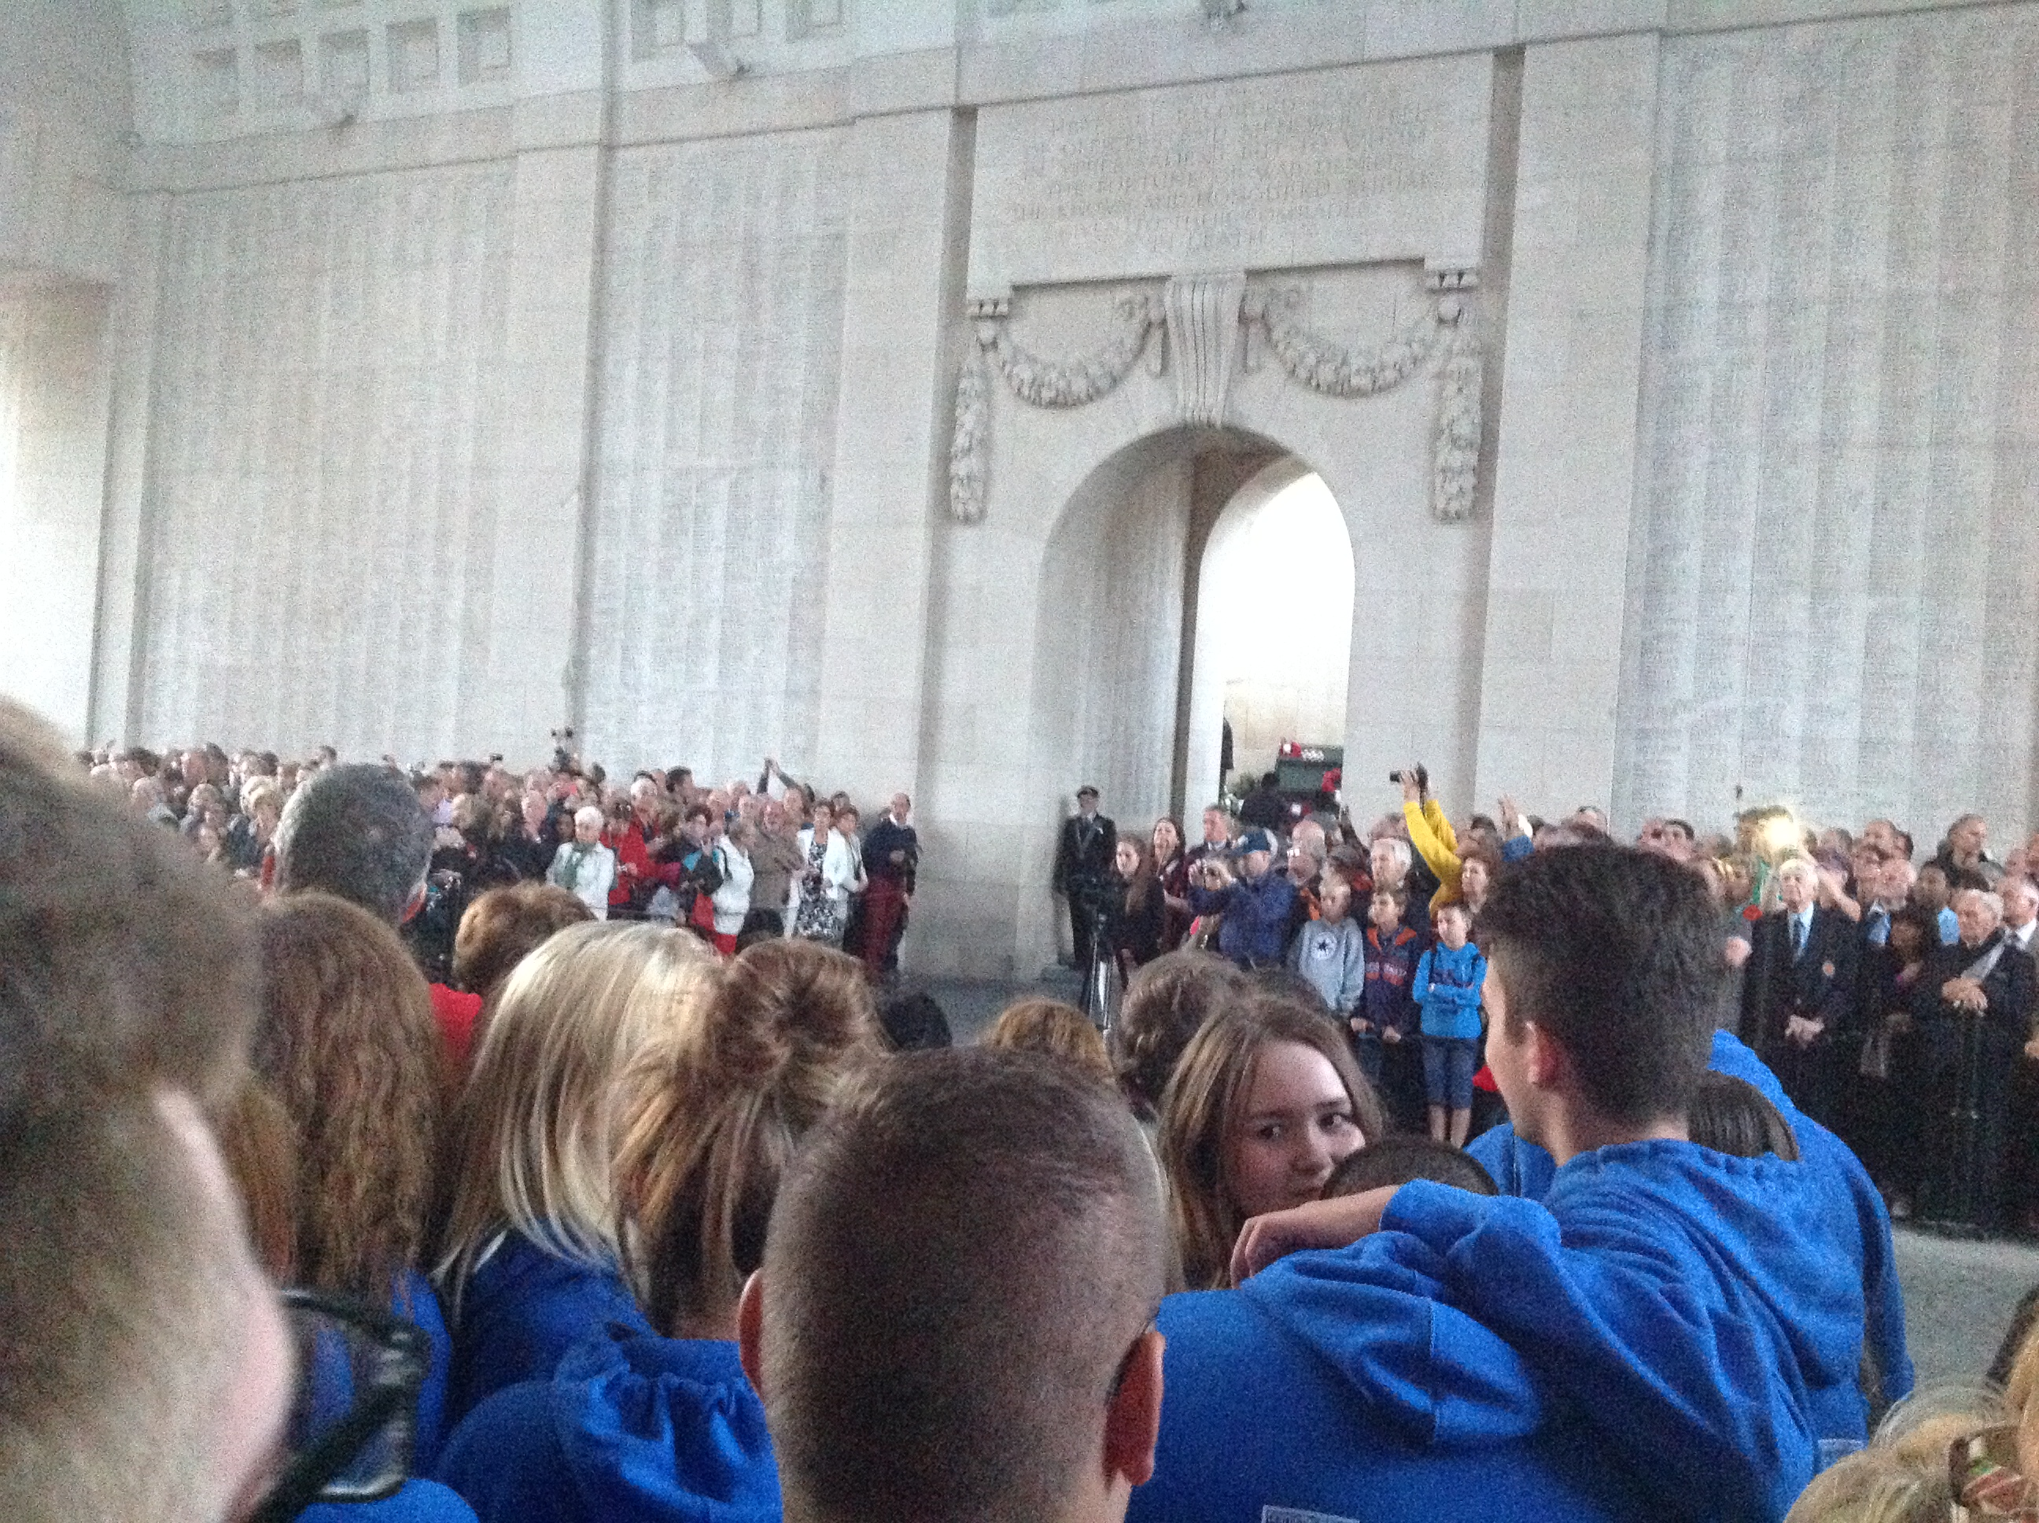
Us!

Slide 19
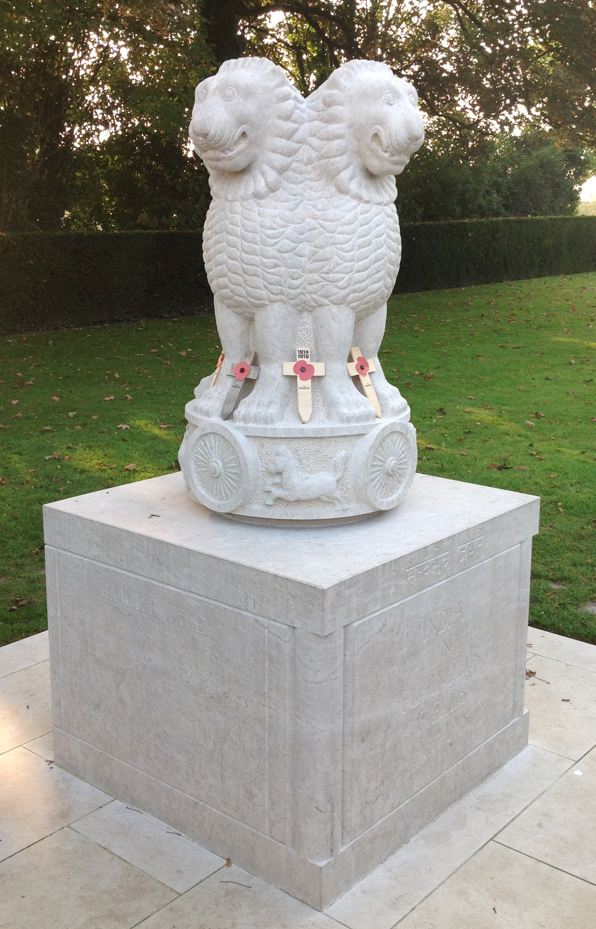
This is the memorial to all of the Indian soldiers killed in the Ypres area.

Slide 20
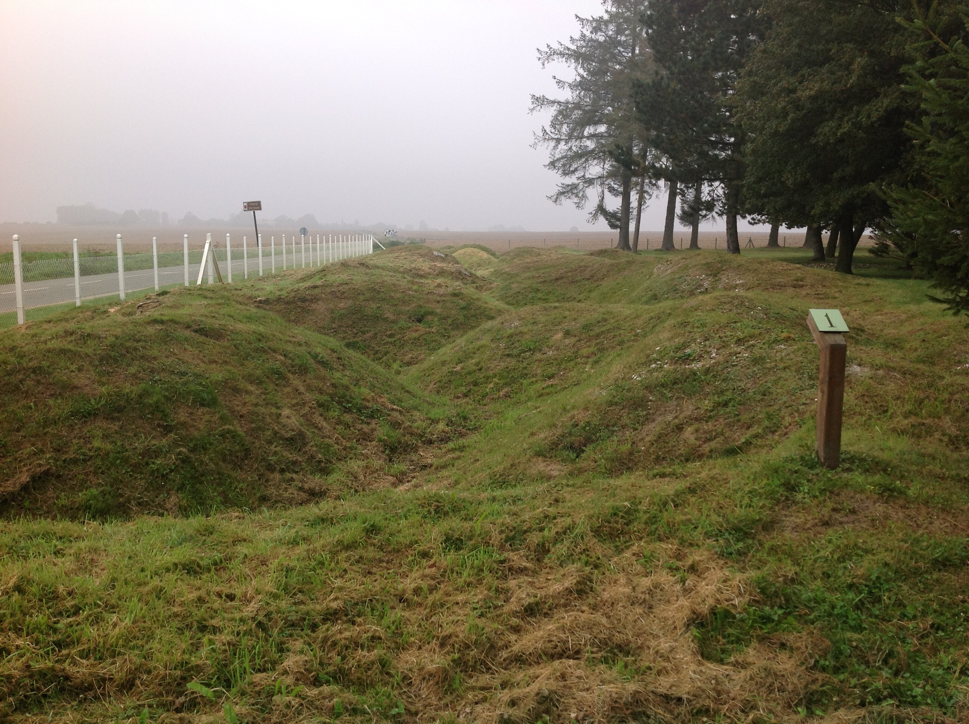
On our second day at the battlefields the first place we visited was Beaumont Hamel.

Slide 21
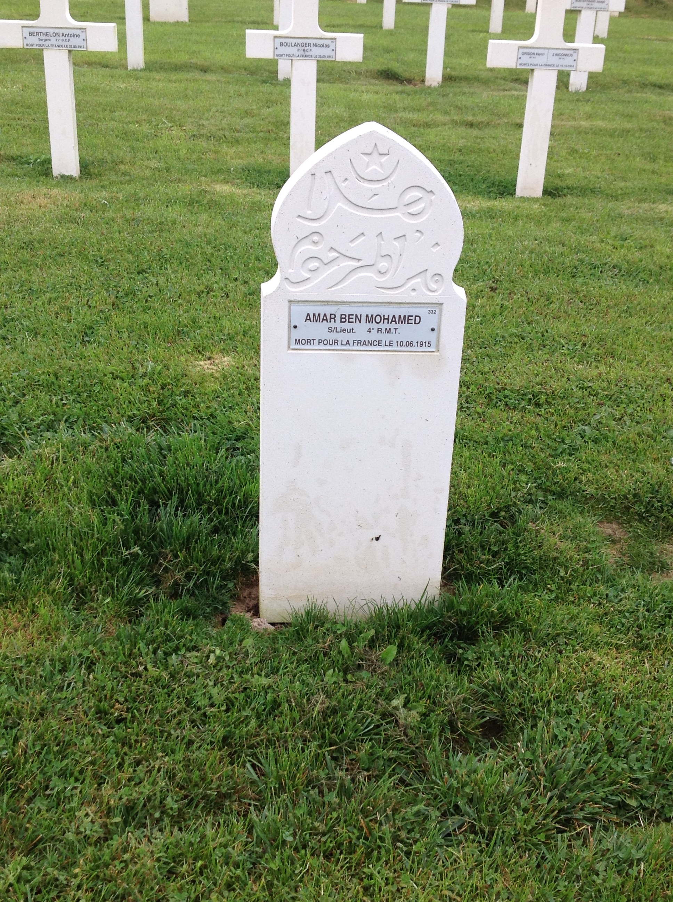
This is the grave of a Muslim soldier who fought in the French army.

Slide 22
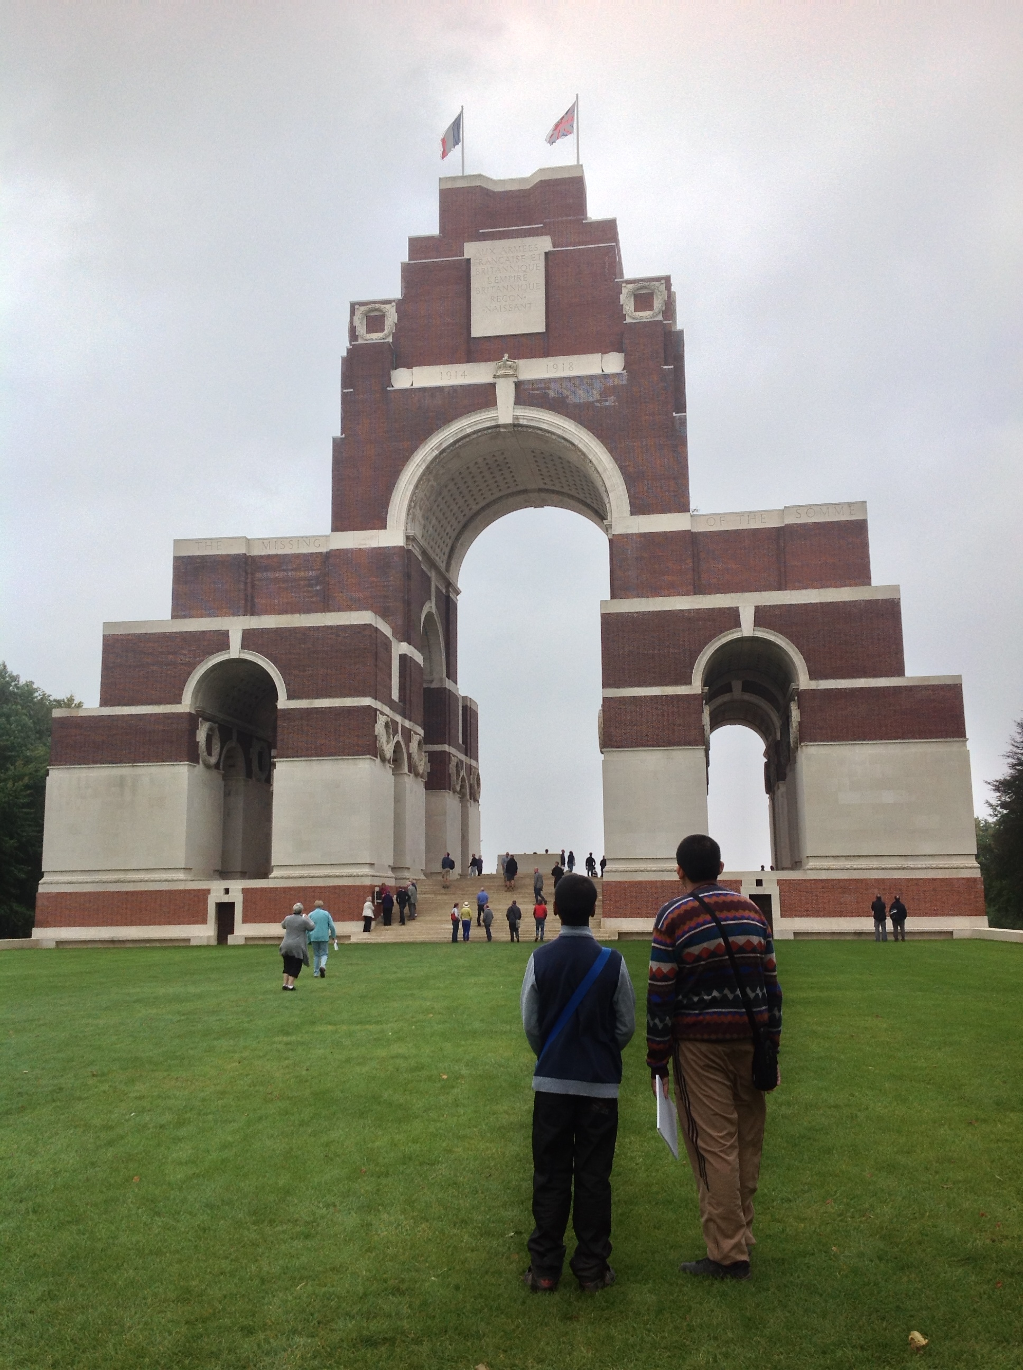
This is the Thiepval memorial. On it are the names of 72,000 soldiers killed on the Somme whose bodies were not found.

Slide 23
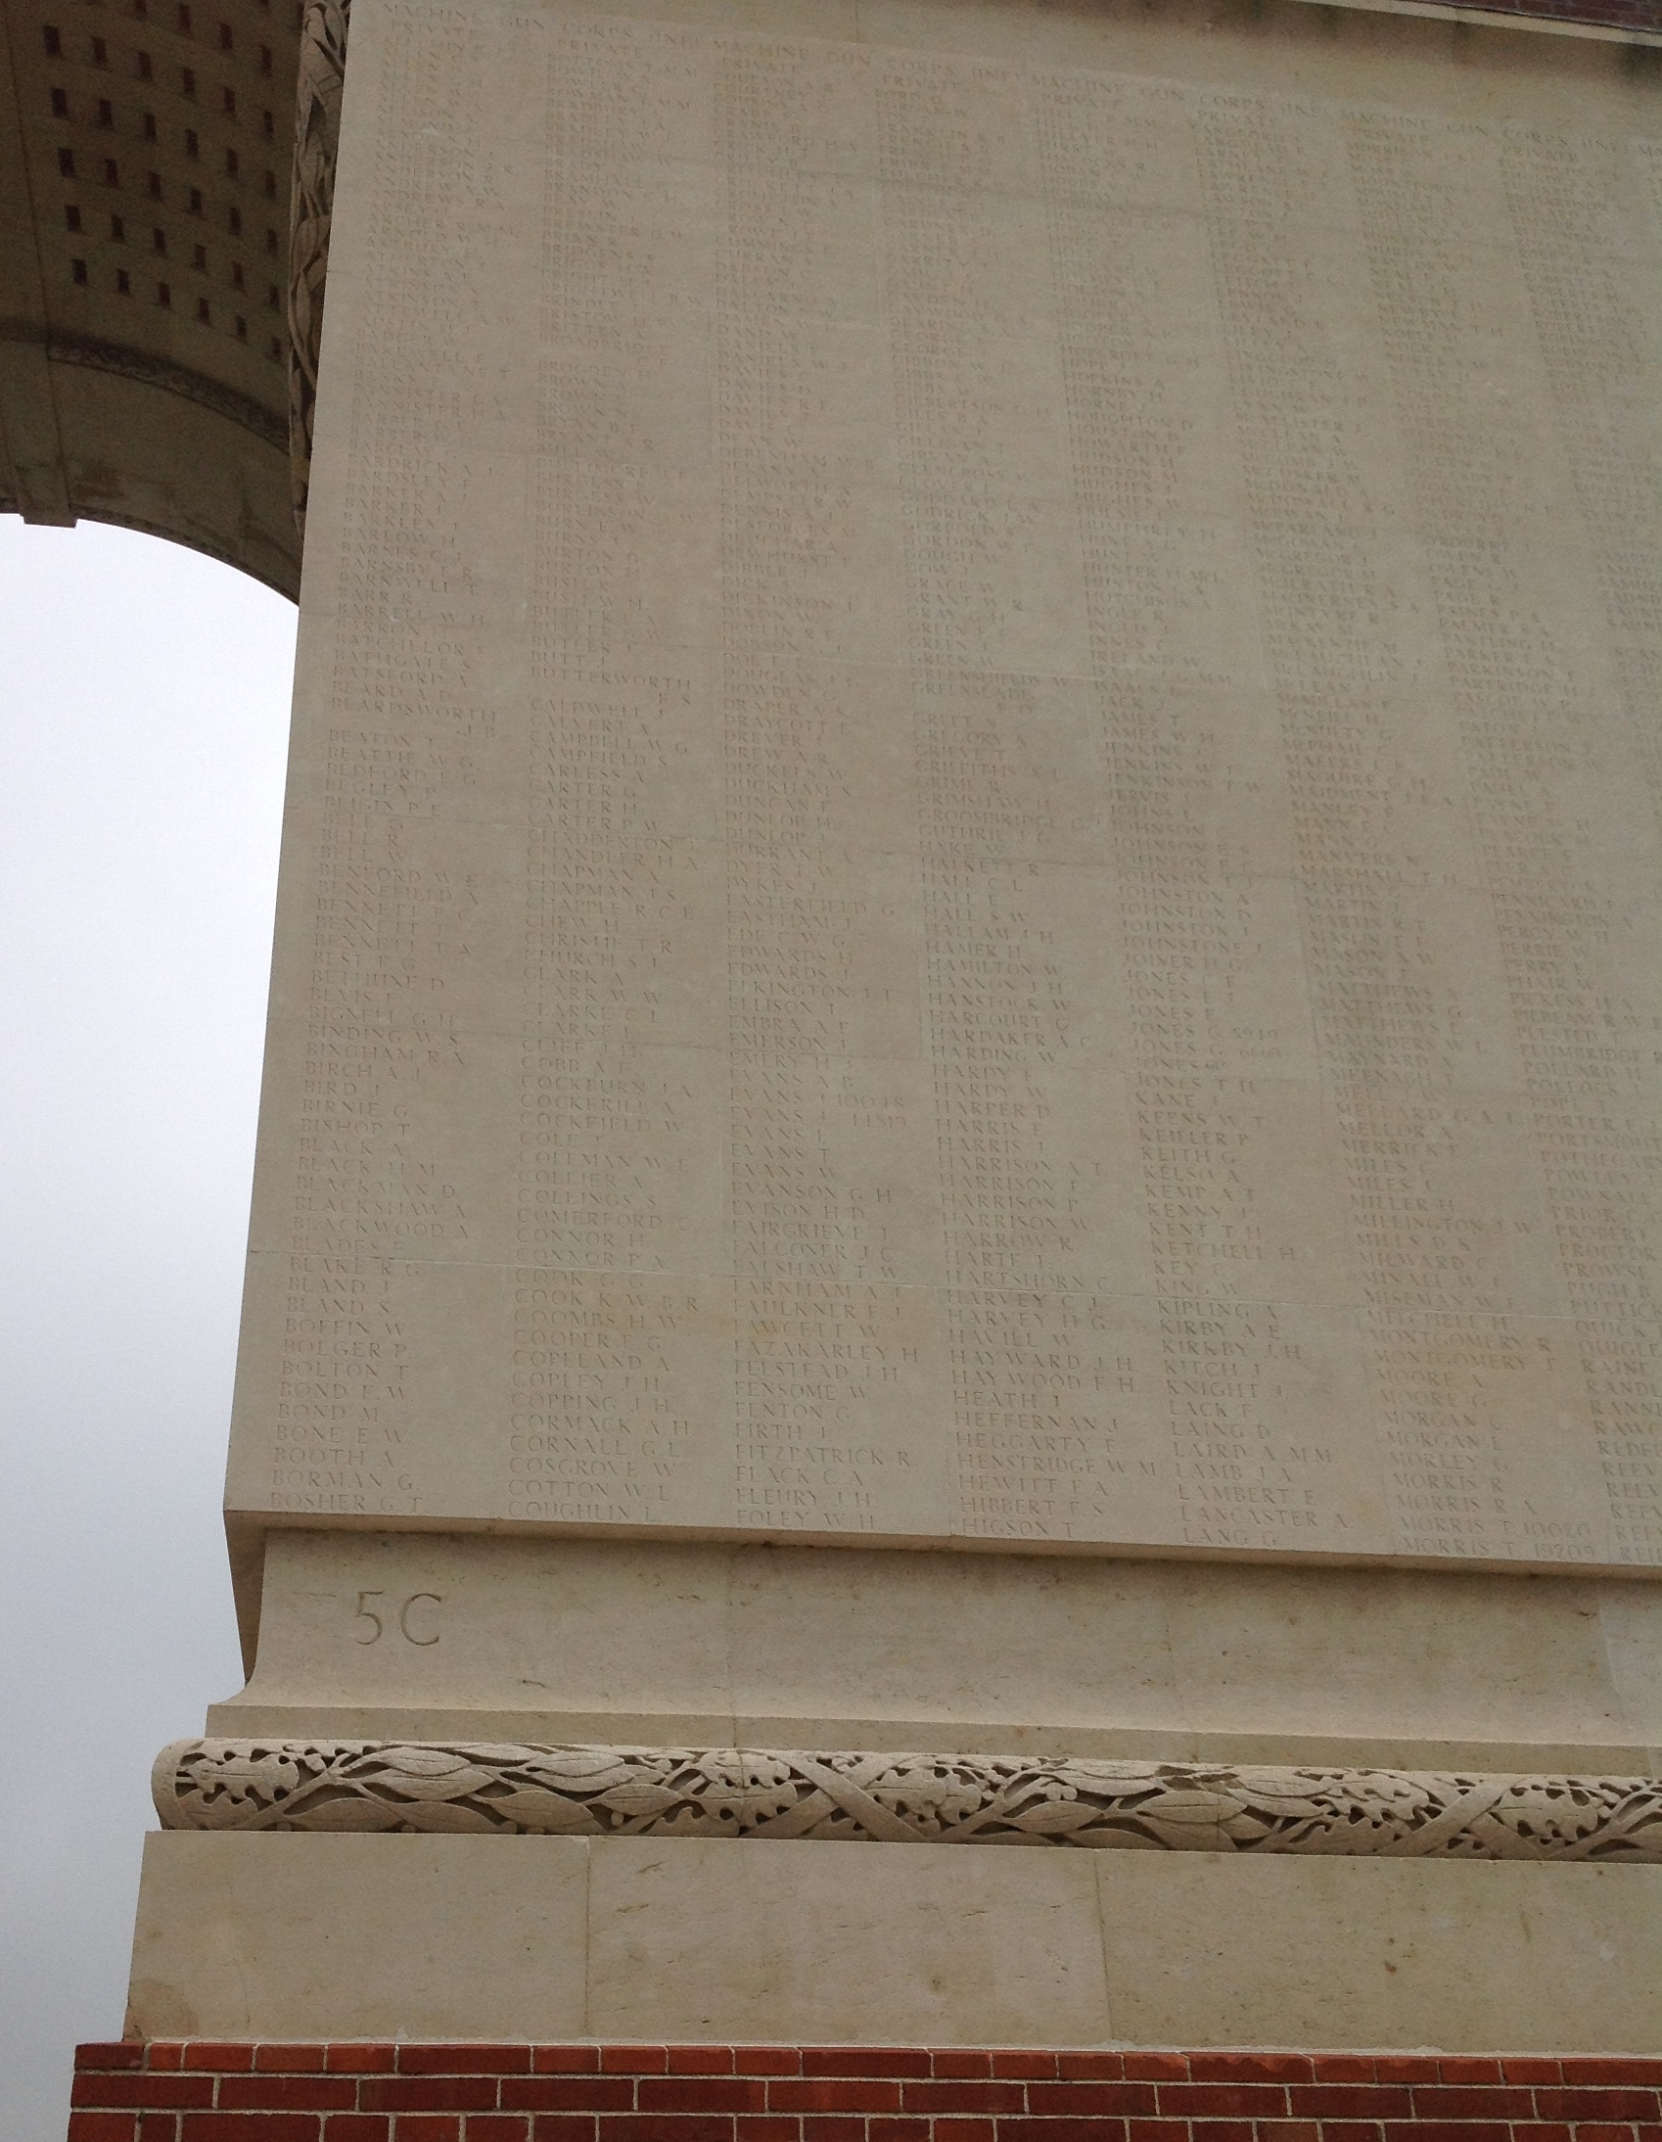
On this panel is the name of Oliver Evans, an ex Moat student

Slide 24
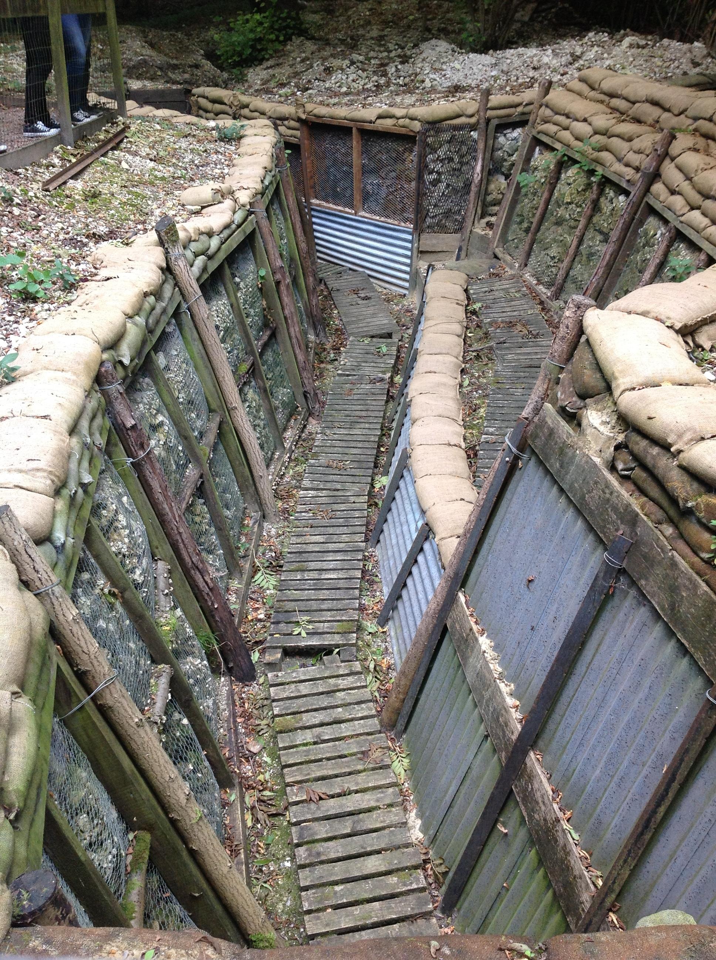
Restored trenches on the Somme

Slide 25
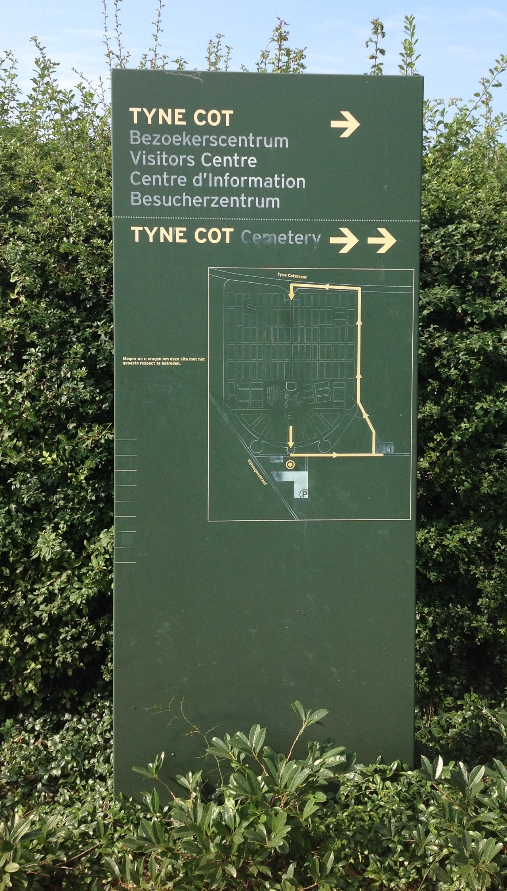
The last place we visited was Tyne Cott, the largest British military cemetery in the world.
There are 11,956 men buried here, 8,369 are unidentified.
A further 35,000 soldiers are commemorated on the memorial wall whose bodies were never found.

Slide 26
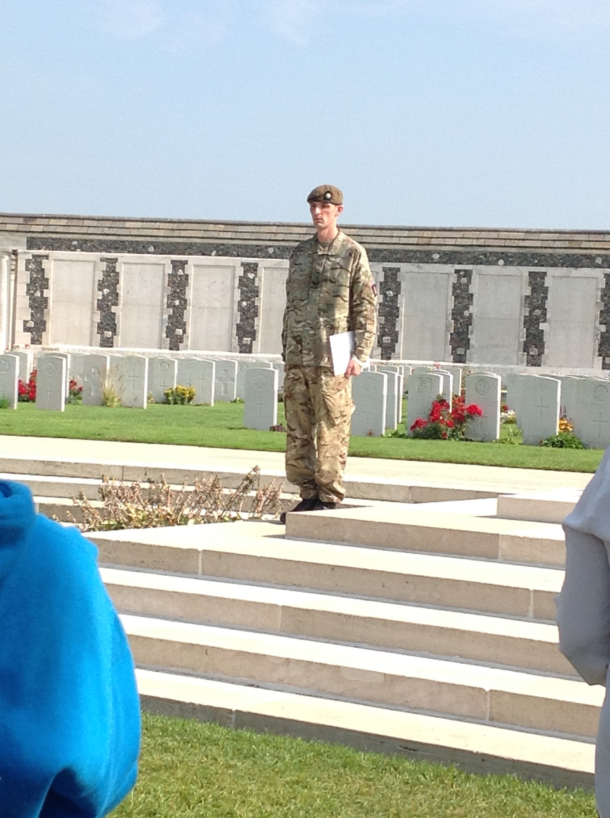
We took part in a remembrance ceremony before we began the journey home.

